Slide 1

Change of Keywords in Content

Slide 2
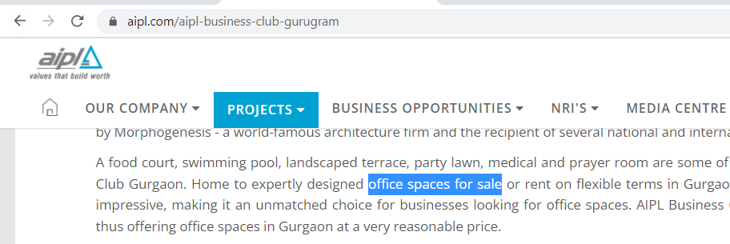
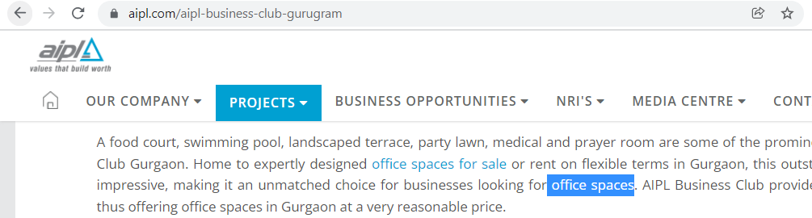
Keyword in Content - https://aipl.com/aipl-business-club-gurugram
Replace office spaces for sale with commercial office space for sale
Replace office spaces with office on lease in gurgaon

Slide 3
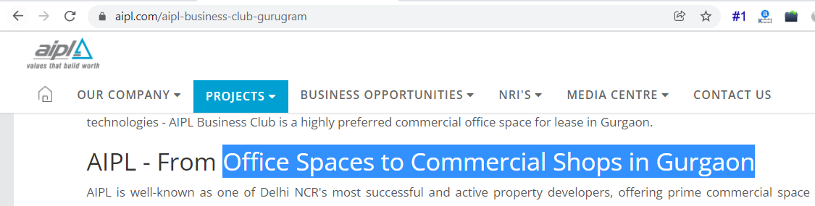

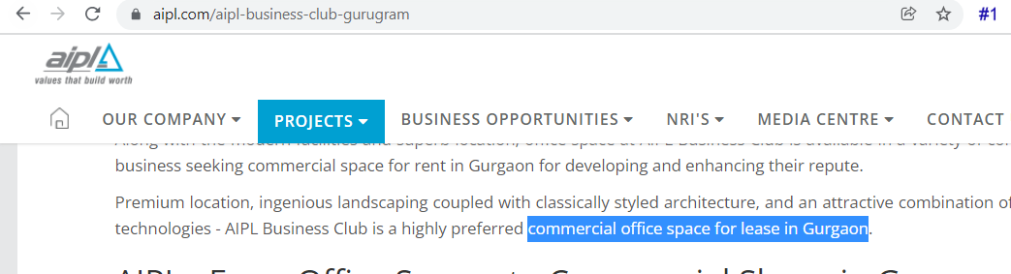
Keyword in Content - https://aipl.com/aipl-business-club-gurugram
Replace Office Spaces to Commercial Shops in Gurgaon with Commercial Office Space to Retail Shops for Sale & Rent in Gurgaon
Replace It is one of the best projects on Golf Course Extension Road, offering commercial shops and offices in Gurgaon with It is one of the best projects, offering commercial shops and offices spaces for rent on Golf Course Extension Road
Replace commercial office space for lease in Gurgaon with commercial property for rent in gurgaon

Slide 4
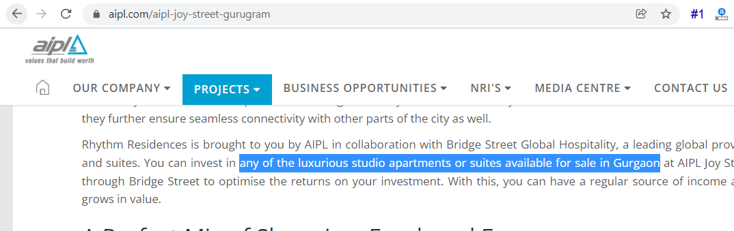
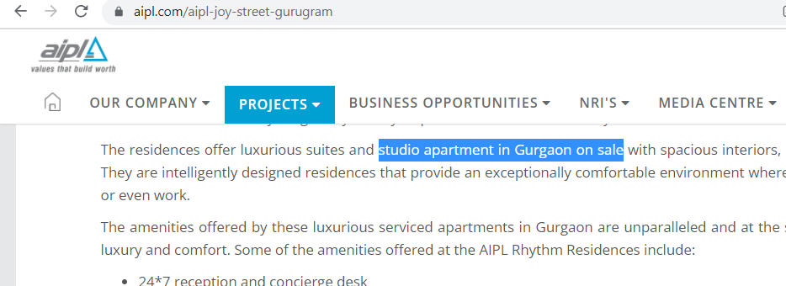

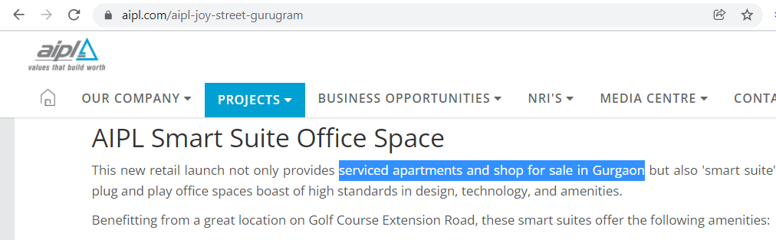
Keyword in Content - https://aipl.com/aipl-joy-street-gurugram
Replace any of the luxurious studio apartments or suites available for sale in gurgaon with any of the suites or luxury studio apartment in Gurgaon on sale
Replace studio apartments for sale in Gurgaon with studio apartment in Gurgaon on sale
Replace apartment with 1 bhk apartment in gurgaon
Replace serviced apartments and shop for sale in Gurgaon with shops and 1 bhk flat in gurgaon

Slide 5
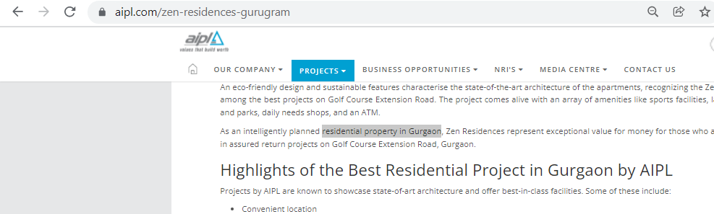
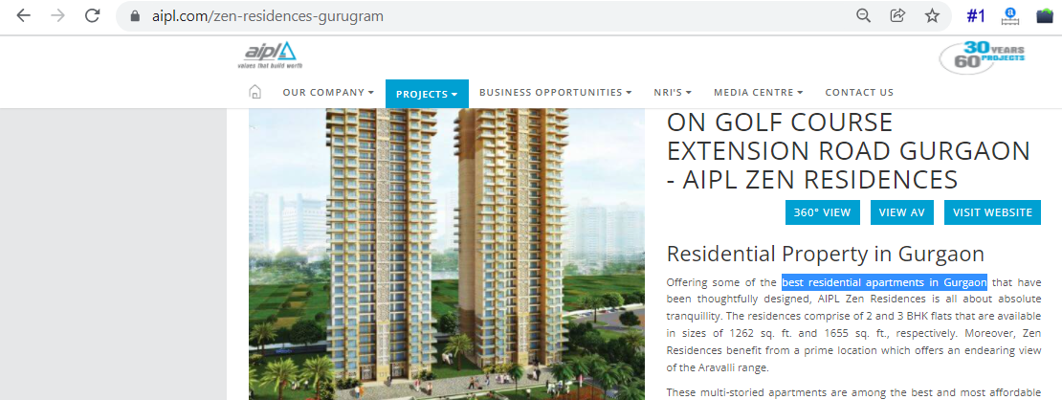
Keyword in Content - https://aipl.com/zen-residences-gurugram
Replace residential property in Gurgaon with residential project in gurgaon
Replace best residential apartments in Gurgaon with best residential project in gurgaon

Slide 6
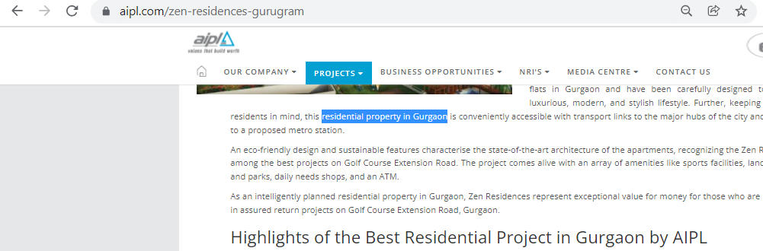
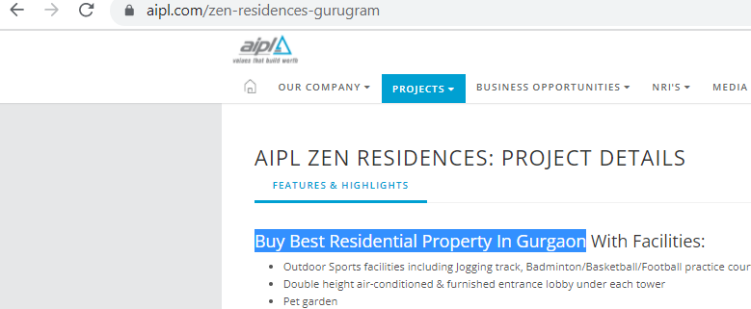
Keyword in Content - https://aipl.com/zen-residences-gurugram
Replace Residential Property in Gurgaon with best residential project in gurgaon
Replace best residential apartments in Gurgaon with best residential project in gurgaon

Slide 7
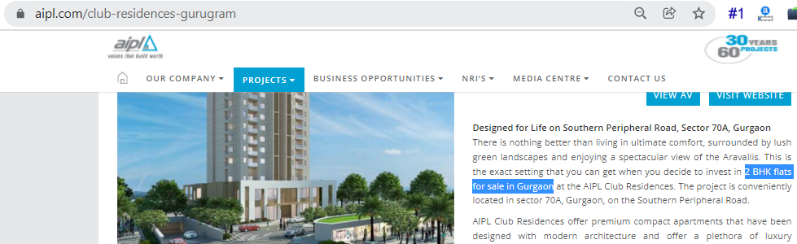
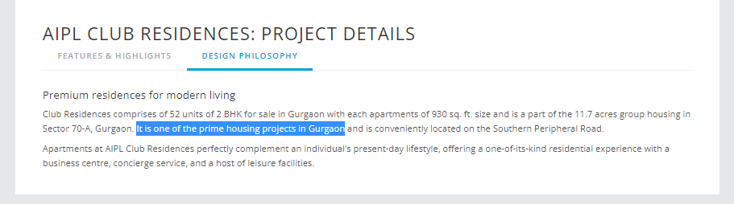
Keyword in Content - https://aipl.com/club-residences-gurugram
Replace 2 BHK flats for sale in Gurgaon with housing projects in gurgaon
Replace It is one of the prime housing projects in Gurgaon with It is one of the best housing projects in Gurgaon

Slide 8
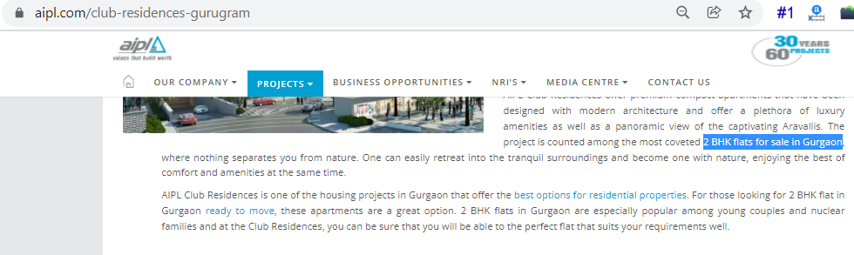
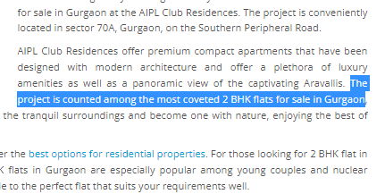
Keyword in Content - https://aipl.com/club-residences-gurugram
Replace 2 BHK flats for sale in Gurgaon with best housing projects in gurgaon
Replace The project is counted among the most coveted 2 BHK flats for sale in Gurgaon with The project is counted as the best housing projects in Gurgaon

Slide 9
Thank You

